Slide 1



REPORT ON Market and Business Environment Report— Plant Micronutrients
Prepared By:
Prepared For:
www.chemanalyst.com
January 09, 2022

Slide 2
Report Content
Sl. No.
Report Content
Page No.
1
PRODUCT OVERVIEW
4
2
RESEARCH METHODOLOGY
6
3
EXECUTIVE SUMMARY
8
4
GLOBAL PLANT MICRONUTRIENTS MARKET OUTLOOK
11
5
INDIA PLANT MICRONUTRIENTS MARKET OUTLOOK
15
6
SUPPLY AND DEMAND ANALYSIS
37
7
IMPORT & EXPORT
38
8
PRICE BENCHMARKING
39
9
VALUE CHAIN ANALYSIS
47
10
COMPETITIVE LANDSCAPE
50

Slide 3

Plant Micronutrients

Slide 4


Product Overview- Plant Micronutrients
Micronutrients are essential plant nutrients that are found in trace amounts in tissue but play an imperative role in plant growth and development. Without these nutrients, plant nutrition would be compromised leading to potential declines in plant productivity. Of the 17 elements essential for plant growth, eight are micronutrients: boron (B), chlorine (CI), copper (Cu), iron (Fe), manganese (Mn), molybdenum (Mo), zinc (Zn) and nickel (Ni).
Mineral elements nurture horticultural crops and also crops of cereals, pulses, oilseeds, spices, and plantation. In spite of the low demand, critical plant functions are hindered if micronutrients are unavailable, which results in plant deformations, lower yield, and diminished growth. Micronutrients are crucial for plant growth and play an important role in balancing crop nutrition.
There is increasing interest from the agricultural community in micronutrient fertilization for a variety of reasons including:
soil erosion and long-term cropping have resulted in the removal of micronutrients from soils;
increasing crop yields generally leads to greater micronutrient removal rates in grain and other harvested products; and
the widespread replacement of micronutrient-rich manures with mineral fertilizers has reduced micronutrient addition from fertilizer sources. Collectively, these factors have led farmers to question whether micronutrient fertilization may now be required to meet the changing demands of crop nutrition.

Slide 5

RESEARCH METHODOLOGY

Slide 6
Research Methodology
The methodology for this study was based on exhaustive Secondary Research followed by extensive Primary Research. ChemAnalyst deployed a dedicated team who worked dedicatedly for the Client to meet research objectives.
Phase-I: Secondary Search
The team conducted exhaustive secondary research to collect the information on required set of data /information
Phase-II: Formulating Questionnaire & Developing List of Respondents
Based on understanding developed though secondary search, ChemAnalyst team formulated a guideline and developed list of respondents to ask specific questions related with the project objectives for each type of stakeholders (Manufactures, Distributors/ Traders/ Exporters / Importers, Government/ Research/ Regulatory Organisations/ Associations and Industry experts.
Phase-III: Extensive Primary Search
ChemAnalyst executed primary surveys targeting key participants including industry experts through Telephonic/ Face to Face methodology. ChemAnalyst performed periodical checks on data being collected through field surveys with logic checks and analyze survey results.
We completed multiple interviews in one organisation at different levels (Mid-Senior) and departments (Sales, Marketing, Production, etc)
Phase-IV: Analysis of Information Developed and Submission of Report
ChemAnalyst completed the analysis of collected set of information for target products and summarized key findings to client in the form of Report

Slide 7
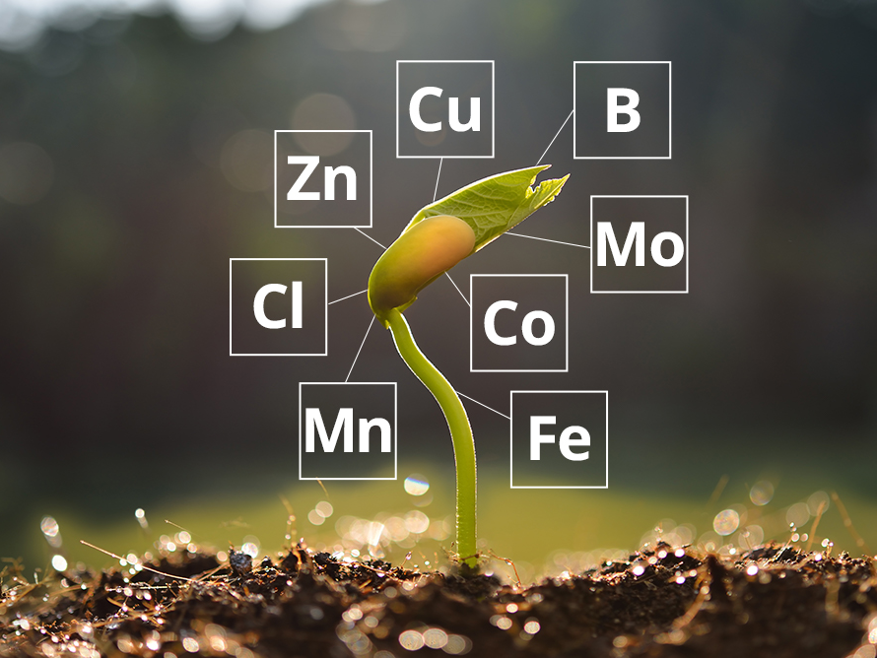
EXECUTIVE SUMMARY

Slide 8
Executive Summary
India Plant Micronutrients Market Size, By Value (USD Billion), 2017, 2019, 2021, 2025F, 2027F
CAGR 2025E-2027F
9.2%
India Plant Micronutrients market stood at USD 0.6 billion and is expected to reach USD 1.1 billion at a CAGR of 9.2% by 2030
CAGR 2017-2021
8.8%
Global Market 2017: USD 3.2 Billion
2021: USD 4.1 Billion
2027: USD 6.5 Billion
India Plant Micronutrients Market Size, By Volume (KT), 2017, 2019, 2021, 2025F, 2027F
CAGR 2017-2021
8.3%
CAGR 2021-2027F
8.8%
Initiatives such as “Make in India” and the PLI Scheme improve the manufacturing sector dynamics of India, and hence more industries are established.
Global Market 2017: 3118.8 KT
2021: 3953.7 KT
2027: 6100.4 KT
Source: ChemAnalyst

Slide 9
Executive Summary
India Plant Micronutrients Market, By Type, By Value (USD Billion), 2021 and 2027F
Zinc Sulphate contributes maximum to the market of micronutrients reaching the value of 0.2 Billion in 2021, followed by ferrous sulphate, boric acid and manganese sulphate.
India Plant Micronutrients Market, By Type, By Value (KT), 2021 and 2027F
The demand for Plant Micronutrients from zinc sulphate stood at 197.1 KT in 2021. India's need for plant micronutrients is boosted by rising manufacturing activity and helpful government measures.
Source: ChemAnalyst

Slide 10

Global Plant Micronutrients Market Outlook

Slide 11
Global Plant Micronutrients Market, By Value & Volume
Figure 1: Global Plant Micronutrients Market Size, By Value (USD Billion) & By Volume (in KT), 2017, 2019, 2021, 2025F, 2027F
CAGR 2017-2021
By Value: 6.8%
CAGR 2021-2027F
By Value: 8.3%
CAGR 2017-2021
By Volume: 6.1%
CAGR 2021-2027F
By Volume: 7.6%
Global Plant Micronutrients market stood at USD 3.6 billion and is expected to reach USD 6.5 billion at a CAGR of 8.3% by 2027
This is attributable to the deteriorating soil quality in cultivated lands. Micronutrients for crops are essential for plant growth and metabolic processes.
The market for crop micronutrients is expanding as a result of factors like rising public awareness of the advantages of crop micronutrients for crop productivity and yields.
Source: ChemAnalyst

Slide 12
Global Plant Micronutrients Market, By Value
Figure 2: Global Plant Micronutrients Market, By Type, By Value (USD Billion), 2017, 2019, 2021, 2025F, 2027F
Total in USD Billion
3
3
4
5
6
Others: Curpic ammonium phosphate, Molybdenum trioxide, Ammonium molybdate, Calcium chloride, Potassium chloride etc.
Zinc Sulphate is the most demanded micronutrient globally, having a market share of more than 30%, and it stood at USD 1.4 billion in FY2021.
In the forecast period, it is expected that zinc sulphate will dominate the plant micronutrients with a market share of over 30%.
Source: ChemAnalyst

Slide 13
Global Plant Micronutrients Market, By Volume
Figure 3: Global Plant Micronutrients Market, By Type, By Volume (KT), 2017, 2019, 2021, 2025F, 2027F
Total in KT
3118
3539
3954
5243
6100
Others: Curpic ammonium phosphate, Molybdenum trioxide, Ammonium molybdate, Calcium chloride, Potassium chloride etc.
Source: ChemAnalyst

Slide 14
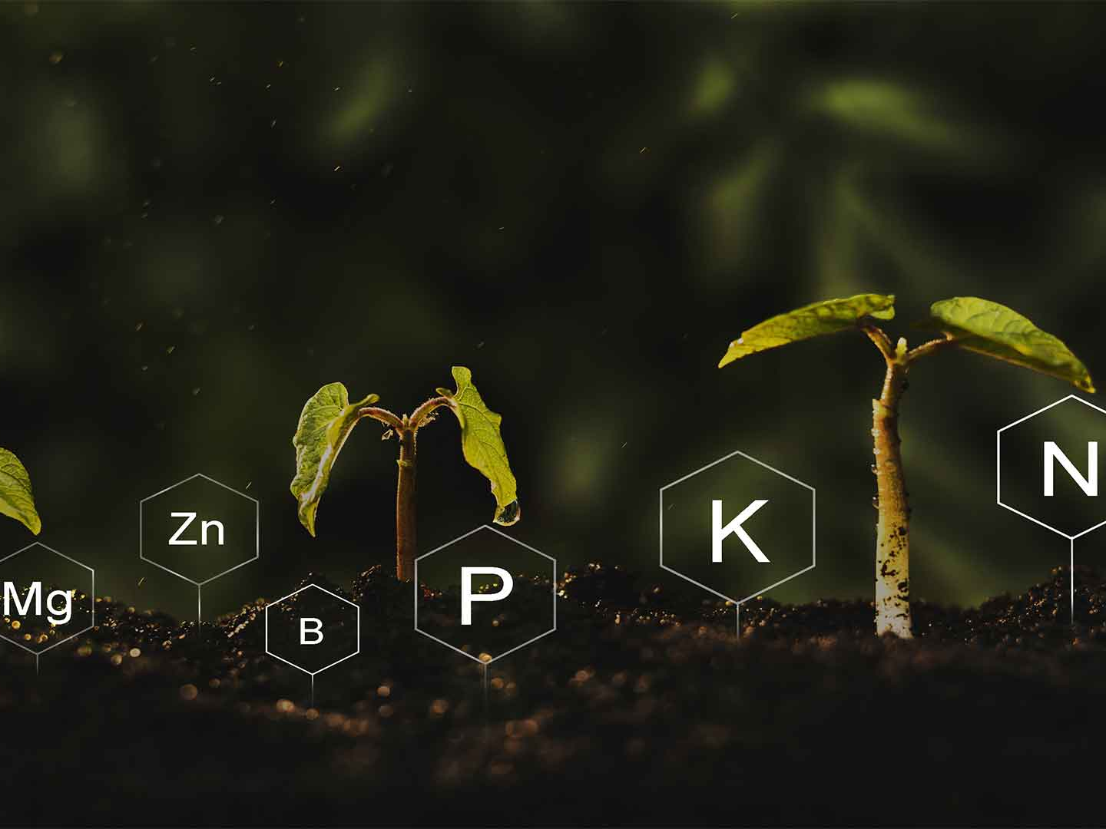
India Plant Micronutrients Market Outlook

Slide 15
India Plant Micronutrients Market, By Value & Volume
Figure 4: India Plant Micronutrients Market Size, By Value (USD Billion) & By Volume (in KT), 2017, 2019, 2021, 2025F, 2027F
CAGR 2017-2021
By Value: 8.8%
CAGR 2021-2027F
By Value: 9.2%
CAGR 2017-2021
By Volume: 8.3%
CAGR 2021-2027F
By Volume: 8.8%
India Plant Micronutrients market stood at USD 0.6 billion and is expected to reach USD 1.1 billion at a CAGR of 9.2% by 2027.
Micronutrients are essential for a balanced diet and a great tool for farmers to improve crop quality and yield.
The market value for agricultural micronutrients has increased as a result of the expanding trend of biofortification in mungbean, wheat, maize, potatoes, and sweet potatoes.
Source: ChemAnalyst

Slide 16
India Plant Micronutrients Market, By Value
Figure 5: India Plant Micronutrients Market, By Type, By Value (USD Billion), 2017, 2019, 2021, 2025F, 2027F
Total in USD Billion
0.4
0.5
0.6
0.9
1.1
Others: Curpic ammonium phosphate, Molybdenum trioxide, Ammonium molybdate, Calcium chloride, Potassium chloride etc.
Zinc Sulphate remains the highest demanded micronutrient in India in terms of value, having a market share of more than 40%, and it stood at USD 0.2 billion in FY2021.
Source: ChemAnalyst

Slide 17
India Plant Micronutrients Market, By Volume
Figure 6: India Plant Micronutrients Market, By Type, By Volume (KT), 2017, 2019, 2021, 2025F, 2027F
Total in KT
356
411
489
685
814
Others: Curpic ammonium phosphate, Molybdenum trioxide, Ammonium molybdate, Calcium chloride, Potassium chloride etc.
Source: ChemAnalyst

Slide 18
India Plant Micronutrients Market, By Value
Figure 7: India Plant Micronutrients Market, By Region, By Value (USD Billion), 2017, 2019, 2021, 2025F, 2027F
Total in USD Billion
0.4
0.5
0.6
0.9
1.1
Others: Curpic ammonium phosphate, Molybdenum trioxide, Ammonium molybdate, Calcium chloride, Potassium chloride etc.
South Region holds the largest market share in plant micronutrients market with highest consumption of fertilizers in the FY 2020-21.
In the forecast period, it is expected that south region will dominate the plant micronutrients market with a market share of over 30%.
Source: ChemAnalyst

Slide 19
India Plant Micronutrients Market, By Volume
Figure 8: India Plant Micronutrients Market, By Type, By Volume (KT), 2017, 2019, 2021, 2025F, 2027F
Total in KT
356
411
489
685
814
Others: Curpic ammonium phosphate, Molybdenum trioxide, Ammonium molybdate, Calcium chloride, Potassium chloride etc.
Source: ChemAnalyst

Slide 20
India Plant Micronutrients Market Share, By Company, By Volume
Clean Agro Fertilizer and Chemical Private Limited holds the major share in the India Plant Micronutrients market with 17.2%, followed by Deepak Fertilizers and Petrochemicals Corporation Limited holding 13.3% of market.
Source: ChemAnalyst

Slide 21
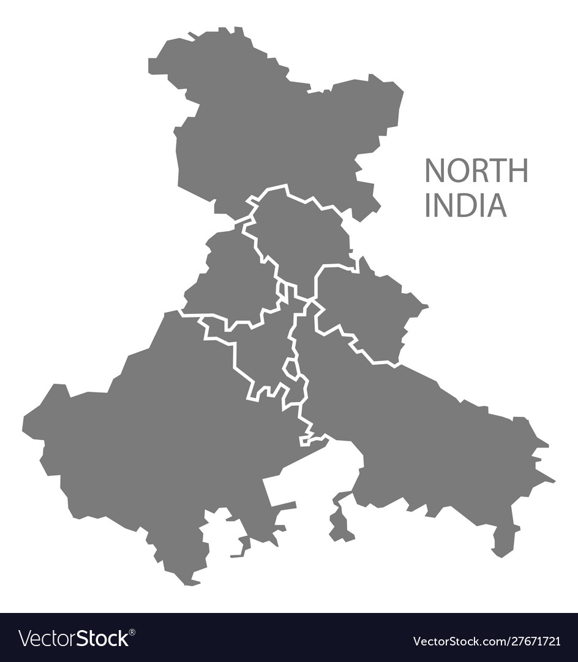
North India Plant Micronutrients Market Outlook

Slide 22
North India Plant Micronutrients Market, By Value & Volume
Figure 9: North India Plant Micronutrients Market Size, By Value (USD Billion) & By Volume (in KT), 2017, 2019, 2021, 2025F, 2027F
CAGR 2017-2021
By Value: 8.8%
CAGR 2021-2027F
By Value: 9.3%
CAGR 2017-2021
By Volume: 8.3%
CAGR 2021-2027F
By Volume: 8.9%
North India Plant Micronutrients market stood at USD 0.2 billion in 2021 and is expected to reach USD 0.3 billion at a CAGR of 9.3% by 2027.
In terms of volume, the market stood at 149.3 KT in 2021, and is expected to reach 249.1 KT at a CAGR of 8.9% by 2027.
Increasing population pressure and overexploitation of productive lands creates serious problem of lowering the fertility status of soil and it leads to deterioration of soil.
Source: ChemAnalyst

Slide 23
North India Plant Micronutrients Market, By Value
Figure 10:North India Plant Micronutrients Market, By Type, By Value (USD Billion), 2017, 2019, 2021, 2025F, 2027F
Total in USD Billion
0.1
0.2
0.2
0.3
0.3
Others: Curpic ammonium phosphate, Molybdenum trioxide, Ammonium molybdate, Calcium chloride, Potassium chloride etc.
Source: ChemAnalyst

Slide 24
North India Plant Micronutrients Market, By Volume
Figure 11: North India Plant Micronutrients Market, By Type, By Volume (KT), 2017, 2019, 2021, 2025F, 2027F
Total in KT
108
125
149
209
249
Others: Curpic ammonium phosphate, Molybdenum trioxide, Ammonium molybdate, Calcium chloride, Potassium chloride etc.
Source: ChemAnalyst

Slide 25
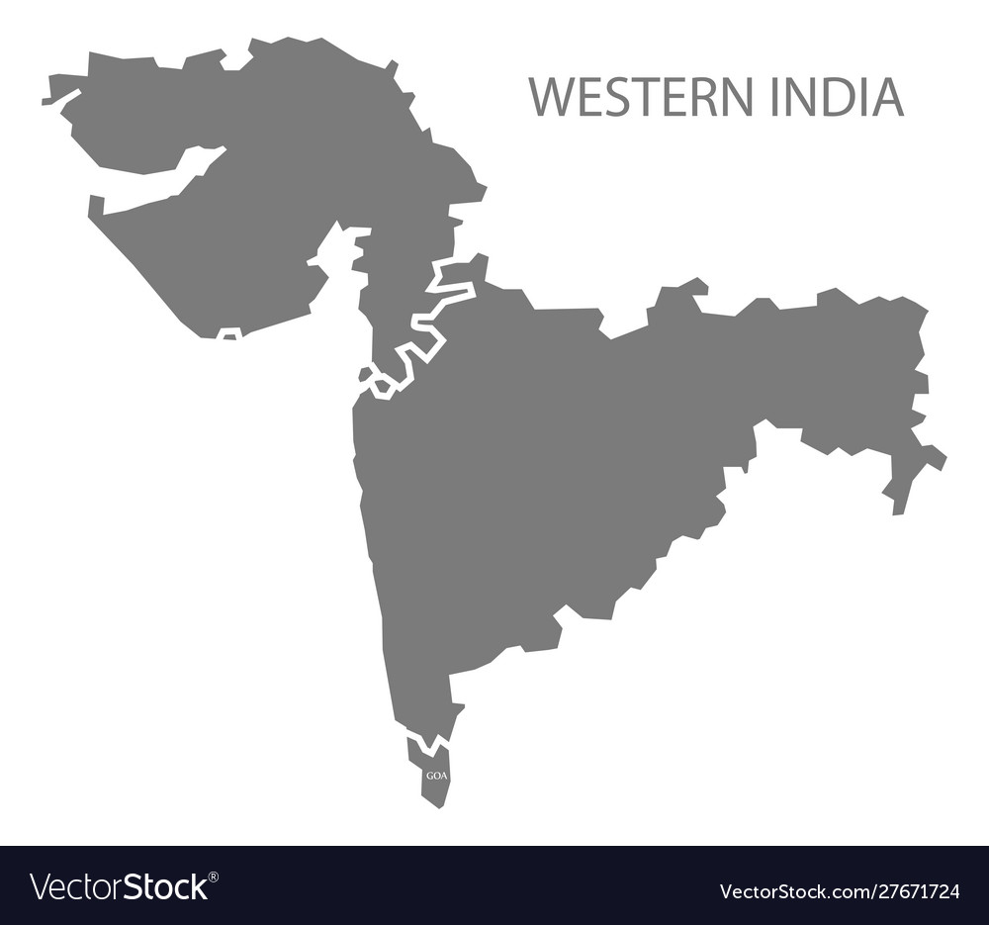
West India Plant Micronutrients Market Outlook

Slide 26
West India Plant Micronutrients Market, By Value & Volume
Figure 12: West India Plant Micronutrients Market Size, By Value (USD Billion) & By Volume (in KT), 2017, 2019, 2021, 2025F, 2027F
CAGR 2017-2021
By Value: 8.8%
CAGR 2021-2027F
By Value: 9.4%
CAGR 2017-2021
By Volume: 8.3%
CAGR 2021-2027F
By Volume: 8.9%
West India Plant Micronutrients market stood at USD 0.1 billion and is expected to reach USD 0.2 billion at a CAGR of 8.9% by 2027.
As micronutrients, there are seven important elements for plants: boron (B), zinc (Zn), manganese (Mn), iron (Fe), copper (Cu), molybdenum (Mo), and chlorine (Cl).
Granular NPK fertilisers consistent distribution of micronutrients is achieved via incorporation during manufacturing.
Source: ChemAnalyst

Slide 27
West India Plant Micronutrients Market, By Value
Figure 13:West India Plant Micronutrients Market, By Type, By Value (USD Billion), 2017, 2019, 2021, 2025F, 2027F
Total in USD Billion
0.1
0.1
0.1
0.2
0.2
Others: Curpic ammonium phosphate, Molybdenum trioxide, Ammonium molybdate, Calcium chloride, Potassium chloride etc.
Source: ChemAnalyst

Slide 28
West India Plant Micronutrients Market, By Volume
Figure 14: West India Plant Micronutrients Market, By Type, By Volume (KT), 2017, 2019, 2021, 2025F, 2027F
Total in KT
65
75
89
125
149
Others: Curpic ammonium phosphate, Molybdenum trioxide, Ammonium molybdate, Calcium chloride, Potassium chloride etc.
Source: ChemAnalyst

Slide 29
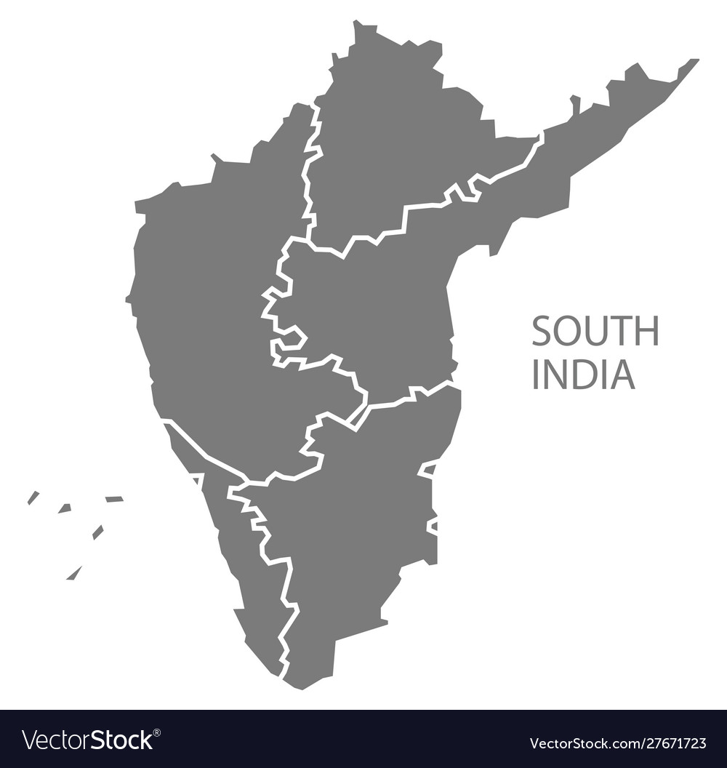
South India Plant Micronutrients Market Outlook

Slide 30
South India Plant Micronutrients Market, By Value & Volume
Figure 15: South India Plant Micronutrients Market Size, By Value (USD Billion) & By Volume (in KT), 2017, 2019, 2021, 2025F, 2027F
CAGR 2017-2021
By Value: 8.8%
CAGR 2021-2027F
By Value: 9.3%
CAGR 2017-2021
By Volume: 8.3%
CAGR 2021-2027F
By Volume: 8.9%
South India Plant Micronutrients market stood at USD 0.2 billion and is expected to reach USD 0.3 billion at a CAGR of 8.9% by 2027.
Granular NPK fertilizers can be coated with powdered micronutrients to reduce the likelihood of segregation.
Row crops frequently receive band treatments of zinc sources along with starting fertilizers.
Source: ChemAnalyst

Slide 31
South India Plant Micronutrients Market, By Value
Figure 16:South India Plant Micronutrients Market, By Type, By Value (USD Billion), 2017, 2019, 2021, 2025F, 2027F
Total in USD Billion
0.1
0.1
0.1
0.2
0.2
Others: Curpic ammonium phosphate, Molybdenum trioxide, Ammonium molybdate, Calcium chloride, Potassium chloride etc.
Source: ChemAnalyst

Slide 32
South India Plant Micronutrients Market, By Volume
Figure 17: South India Plant Micronutrients Market, By Type, By Volume (KT), 2017, 2019, 2021, 2025F, 2027F
Total in KT
113
130
155
217
258
Others: Curpic ammonium phosphate, Molybdenum trioxide, Ammonium molybdate, Calcium chloride, Potassium chloride etc.
Source: ChemAnalyst

Slide 33
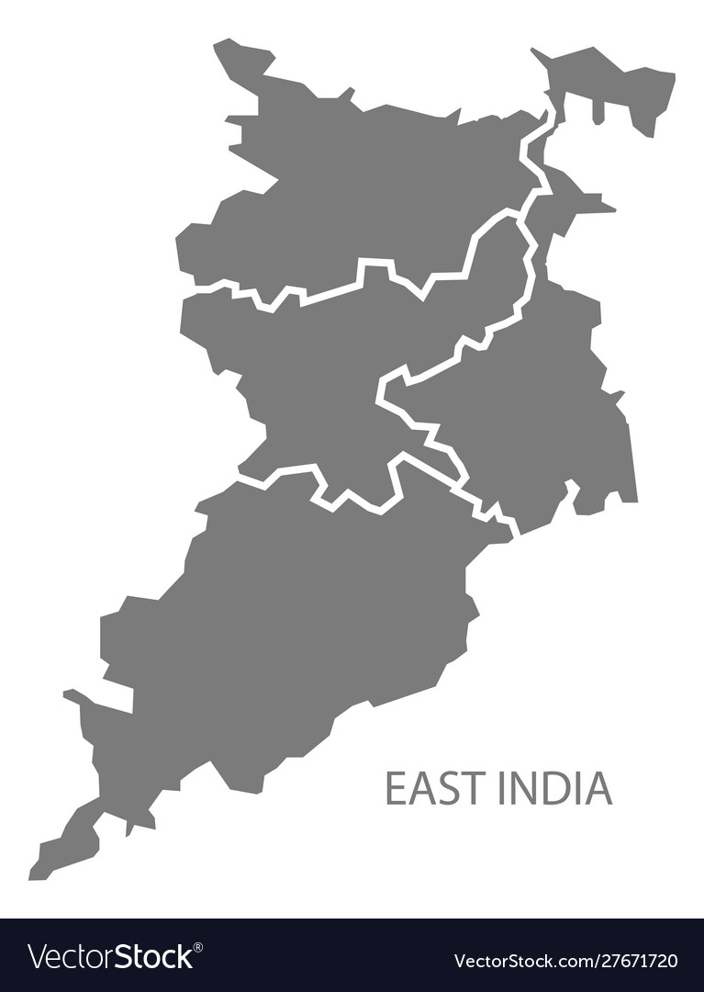
East India Plant Micronutrients Market Outlook

Slide 34
East India Plant Micronutrients Market, By Value & Volume
Figure 18: East India Plant Micronutrients Market Size, By Value (USD Billion) & By Volume (in KT), 2017, 2019, 2021, 2025F, 2027F
CAGR 2017-2021
By Value: 8.7%
CAGR 2021-2027F
By Value: 9.1%
CAGR 2017-2021
By Volume: 8.1%
CAGR 2021-2027F
By Volume: 8.7%
East India Plant Micronutrients market stood at USD 0.1 billion and is expected to reach USD 0.2 billion at a CAGR of 8.7% by 2027.
Micronutrients are crucial to the efficiency with which other nutrients are utilized and to the growth, development, and productivity of the plant.
They can significantly affect root growth, fruit setting and grain filling, seed viability, plant vigor, and general health.
Source: ChemAnalyst

Slide 35
East India Plant Micronutrients Market, By Value
Figure 19: East India Plant Micronutrients Market, By Type, By Value (USD Billion), 2017, 2019, 2021, 2025F, 2027F
Total in USD Billion
0.1
0.1
0.1
0.2
0.2
Others: Curpic ammonium phosphate, Molybdenum trioxide, Ammonium molybdate, Calcium chloride, Potassium chloride etc.
Zinc yields, spotty leaves, and stunted growth are all prevented by zinc sulphate. It can also be used as a fungicide naturally.
Zinc is time-efficient because it treat plants and crops for two to three years after a single application.
Boron helps control the formation of plant cell walls, which also helps control the release of minerals from storage in cells. Boron, which is predominantly found in soil, has a critical impact on plant growth.
Source: ChemAnalyst

Slide 36
East India Plant Micronutrients Market, By Volume
Figure 20: East India Plant Micronutrients Market, By Type, By Volume (KT), 2017, 2019, 2021, 2025F, 2027F
Total in KT
70
81
95
133
157
Others: Curpic ammonium phosphate, Molybdenum trioxide, Ammonium molybdate, Calcium chloride, Potassium chloride etc.
Source: ChemAnalyst

Slide 37
Supply and Demand Analysis
Parameters | FY2017 | FY2019 | FY2021 | FY2025 | FY2027
Production | 216.3 | 218.9 | 330.5 | 350.0 | 380.0
Import | 139.4 | 192.1 | 158.7 | - | -
Export | 0.1 | 0.1 | 0.2 | - | -
Demand | 355.7 | 410.9 | 488.9 | 685.6 | 814.1
Surplus/Gap | - | - | - | -335.6 | -434.1
Existing Capacity | 300.0 | 330.0 | 400.0 | 400.0 | 400.0
Source- ChemAnalyst
In FY 2021, the overall production of micronutrients in India stood at 330.5 KT and had an existing capacity of 400 KT.
Till now industry is operating at approximately 75% of the overall existing capacity.
The import of plant micronutrients majorly came from China which holds 90% of India’s import.
The export market of India plant micronutrients is negligible, exporting a small amount in neighboring countries.

Slide 38
Import, By Volume
Import Top 5 Countries, By Volume (Kilo Tonnes)
Source- ChemAnalyst
India imported 158.7 Kilo tons of micronutrients in FY 2021.
India is the import driven market of micronutrients, importing 90% from China.
Moreover, the export of micronutrients from India is negligible, exporting mainly to Southeast Asian countries like Bangladesh, Myanmar, Laos, Nepal, Sri Lanka etc.

Slide 39
Plant Micronutrients Price Benchmarking (INR/Kg), FY2017 – FY2021
Source- ChemAnalyst
The adequate availability of the copper sulphate pentahydrate in the domestic market has hampered the prices of the product in the market.
The increase in the prices of raw materials of sodium tetraborate have impacted the prices of the product.

Slide 40
Plant Micronutrients Price Benchmarking (INR/Kg), FY2017 – FY2021,
Copper Sulphate Pentahydrate Exports Price Benchmarking (INR/Kg), By Top 5 Countries, FY2017 – FY2021
Copper Sulphate Pentahydrate Imports Price Benchmarking (INR/Kg), By Top 5 Countries, FY2017 – FY2021
Source- ChemAnalyst

Slide 41
Plant Micronutrients Price Benchmarking (INR/Kg), FY2017 – FY2021,
FeSO4.7H2O Exports Price Benchmarking (INR/Kg), By Top 5 Countries, FY2017 – FY2021
FeSO4.7H2O Imports Price Benchmarking (INR/Kg), By Top 5 Countries, FY2017 – FY2021
Source- ChemAnalyst

Slide 42
Plant Micronutrients Price Benchmarking (INR/Kg), FY2017 – FY2021,
Fe EDTA Chelate Exports Price Benchmarking (INR/Kg), By Top 5 Countries, FY2017 – FY2021
Fe EDTA Chelate Imports Price Benchmarking (INR/Kg), By Top 5 Countries, FY2017 – FY2021
Source- ChemAnalyst

Slide 43
Plant Micronutrients Price Benchmarking (INR/Kg), FY2017 – FY2021,
Di Sodium Tetra Borate Exports Price Benchmarking (INR/Kg), By Top 5 Countries, FY2017 – FY2021
Di Sodium Tetra Borate Imports Price Benchmarking (INR/Kg), By Top 5 Countries, FY2017 – FY2021
Source- ChemAnalyst

Slide 44
Plant Micronutrients Price Benchmarking (INR/Kg), FY2017 – FY2021,
Di sodium Octaborate tetrahydrate Exports Price Benchmarking (INR/Kg), By Top 5 Countries, FY2017 – FY2021
Di sodium Octaborate tetrahydrate Imports Price Benchmarking (INR/Kg), By Top 5 Countries, FY2017 – FY2021
Source- ChemAnalyst

Slide 45
Plant Micronutrients Price Benchmarking (INR/Kg), FY2017 – FY2021,
Zinc Sulphate Monohydrate Exports Price Benchmarking (INR/Kg), By Top 5 Countries, FY2017 – FY2021
Zinc Sulphate Monohydrate Imports Price Benchmarking (INR/Kg), By Top 5 Countries, FY2017 – FY2021
Source- ChemAnalyst

Slide 46
Plant Micronutrients Raw Material Price Benchmarking (INR/Kg), FY2018 – FY2025F
Source- ChemAnalyst
Zinc Sulphate prices witnessed an episodic price during FY 2022, as the ongoing Kharif planting season boosted the downstream fertilizer demand.
The borax prices surged in the FY 2022 due to Russia – Ukraine war and the impact of Covid – 19.
A significant decrement in new orders from importing countries and plummeting upstream raw material costs have pushed the prices of Magnesium Sulphate.
The prices of Copper sulphate surged due to increase in the prices of raw materials.

Slide 47
Value Chain- Plant Micronutrients
Manufacturer/Producer
Margin: 7% to 10%
Margin: 10% to 12%
Distributor/Agents
Margin: 3% to 5%
Custom Duty: 10% , GST: 18%
End User
Source- ChemAnalyst
The profit margin for plant micronutrients manufacture is ranging from 7% to 10%. Whereas Distributor/Agents margin is between 3% to 5% .
Manufacturer while dealing directly with the end user take profit ranging from 10% to 12% depending upon the nature of contract that depends upon quantity, payment terms etc.

Slide 48
Market Dynamics
Drivers
The need for micronutrients across the Indian agriculture industry is mostly driven by the rise in demand for high-value crops like nutrient-rich fruits and vegetables.
The Indian government is introducing attractive agricultural programs and providing subsidies to encourage the adoption of agricultural micronutrients as part of its efforts to educate farmers about soil health. For instance, the Government of India (GOI) pushed fortified and customized fertilizers in 2020 and created the Nutrient Based Subsidy (NBS) scheme. To encourage the use of zinc and boron, the government also provided additional subsidies on those materials.
The production of chlorophyll is accelerated by iron. The nodules of legume roots contain iron that serves as an oxygen carrier. The demand for ferrous fertilizers is rising as farmers become more aware of the benefits of iron.
Due to its low cost and simplicity of use, soil application is the most efficient way for applying micronutrients. The use of the soil application approach has been prompted by a lack of improved fertilisation techniques in some areas of India and a lack of understanding among farmers.
Challenges
The lack of knowledge among Indian farmers about the advantages of micronutrients is the main factor limiting the expansion of the micronutrients industry.
The adoption of micronutrients is hampered by low-income farmers ignorance about the nutritional condition of their farmland.
The quantity to use and method of application have a considerable impact on the effectiveness of micronutrient supplements. So, it is crucial to determine the appropriate application rate and technique. Micronutrient if use in excess, can poison the soil and reduce crop output. Thus, a further barrier to the expansion of the agricultural micronutrients market is a lack of awareness about the effective nutrition (other than conventional fertilisers) needed by crops to achieve healthy and timely growth.

Slide 49

COMPETITIVE LANDSCAPE

Slide 50

CLEAN AGRO FERTILIZER AND CHEMICAL PRIVATE LIMITED
North
Clean Agro Fertilizer And Chemical Private Limited were established in 2010.
The company is a global supplier, importer, and distributor of chemicals, minerals, agricultural products, and raw materials.
The company offers a variety of chemical products with diverse applications and uses, servicing a wide range of industries.
Clean Agro has built up foreign relationships with chemical suppliers and manufacturers across the globe to supply high-quality raw materials with competitive pricing.
The company concentrates on providing supply chain solutions to their customers for minerals, chemicals, and raw materials.
The Clean Agro expertise in both sourcing and logistics management which helps in streamlining the supply chains.
The company’s product offering includes various products like adhesives & sealants, animal nutrition & feed, antifreeze & coolant, coatings etc.
West
East
South
Business Setup, FY2021
HQ | Ahmedabad, Gujarat
Plants | Kalol, Gujarat
Key Indicators
Plant Capacity | 80,000 MT
Production Volume, 2021 | 67,000 MT
Total Revenue, FY 2021 | INR 356 Crore
Profit After Tax (PAT) | INR 9 Crore

Slide 51

DEEPAK FERTILISERS AND PETROCHEMICALS CORPORATION
LIMITED
Deepak Fertilizers and Petrochemicals Corporation Limited (DFPCL) entered the fertilizer market in 1992.
One of India's largest and most known producers of bulk and specialty fertilizers today is Smartchem Technologies Limited (STL), a wholly-owned subsidiary of DFPCL. The company's major brand, Mahadhan, is used to sell its fertilizers.
The brand Mahadhan has been awarded various achievements since its establishment, such as the Iconic ET award in 2017, Excellence in Agricultural Practices in 2016, and India’s Most Trusted Brand in 2015 and 2016.
At its brand-new manufacturing facility in Taloja, the company has invested in global INCRO technology.
The company seeks to partner and transfer technology to Indian and international collaborators.
The company plans to improve productivity for 10 million farmers by adopting measures like increased production, wider geographical reach, continuous availability, complete fertilization solution, technology to further strengthen grass-root connections, and research & development.
North
West
East
South
Business Setup, FY2021
HQ | Pune, Maharashtra
Plants | Taloja, Gujarat
Key Indicators
Plant Capacity | 60,000 MT
Production Volume, 2021 | 48,000 MT
Total Revenue, FY 2021 | INR 5808 Crore
Profit After Tax (PAT) | INR 406 Crore

Slide 52

BHAKTI CHEMICALS PVT. LTD.
Bhakti Chemicals Pvt. Ltd. was established in 1995 and is a reputed manufacturer, exporter, importer, and supplier of micronutrients that are well-recognized in both domestic & overseas markets.
The company is also equipped with an in-house R&D department equipped with modern equipment.
The company also has a quality testing laboratory for developing new products and improving existing products.
Bhakti Chemicals offers a diverse range of products that are used by various industries like pharmaceuticals, agriculture, soaps & detergents, personal care, textiles & water treatment, agrochemicals, leather laboratory regents & paints & coatings.
The products of the company are checked on the following parameters such as purity, effectiveness, accurate composition, precise pH value, and longer shelf life.
The company has a sophisticated infrastructure located at Navi Mumbai, MIDC, equipped with high-end equipment and the latest technology.
North
West
East
South
Business Setup, FY2021
HQ | Navi Mumbai, Mumbai
Plants | Navi Mumbai, Mumbai
Key Indicators
Plant Capacity | 40,000 MT
Production Volume, 2021 | 30.000 MT
Total Revenue, FY 2021 | INR 420 Crore
Profit After Tax (PAT) | INR 13 Crore

Slide 53

SAANVI ORGANICS
Saanvi Organics, established in 2010, works only on 100% natural & organic agricultural solutions.
The company is present in multiple states of India, including Harayana, Jharkhand, Andhra Pradesh, Gujarat, Rajasthan, etc.
The company manufactures 100% Natural & Organic fertilizers from different extracts of Trees, Herbs, and Naturally available Minerals from the Earth.
Saanvi Organics offers quality products at industry-leading prices and ensures delivery of the ordered consignments within the stipulated time frame.
The company’s products are researched & developed on the bases of “ARYABHISHAK” & "CHARAK SAMHITA" written by our respected rishi muni from India, Approx. 500 years old indigenous technology.
Saanvi Organics is committed to manufacture quality Products continually and consistently to exceed the needs & expectations of our customers, thereby achieving total customer satisfaction.
North
West
East
South
Business Setup, FY2021
HQ | Ahmedabad, Gujarat
Plants | Ahmedabad, Gujarat
Key Indicators
Plant Capacity | 33,000 MT
Production Volume, 2021 | 28,000 MT
Total Revenue, FY 2021 | INR 400 Crore
Profit After Tax (PAT) | INR 10 Crore

Slide 54

DHARMAJ CROP GUARD LIMITED
Dharmaj Crop Guard Limited was established in 2015 and engaged in the manufacturing, distributing, and marketing a wide range of agrochemical formulations.
Through a network of more than 3,700 dealers and with access to 8 stock depots across India, Dharmaj branded products are sold in 12 states.
Dharmaj caters to more than 600 customers in India and internationally. The company exported its product to more than 60 countries.
Some key customers are Atul Limited, Heranba Industries Limited, Innovative Agritech Private Limited, Meghmani Industries Limited, Bharat Rasayan Limited, Oasis Limited, United Insecticides Private Limited, and Sadik Agrochemicals Co. Ltd.
Dharmaj Crop keeps working to improve manufacturing capabilities by increasing its product line and backward integration.
The company focused on targeting new clients, growing business with current clients, and boosting market share in domestic and foreign markets to increase its presence in the agrochemical market rapidly.
North
West
East
South
Business Setup, FY2021
HQ | Ahemdabad, Gujarat
Plants (2) | Ahemdabad, Gujarat
Key Indicators
Plant Capacity | 30,000 MT
Production Volume, 2021 | 23,000 MT
Total Revenue, FY 2021 | INR 333 Crore
Profit After Tax (PAT) | INR 7 Core

Slide 55

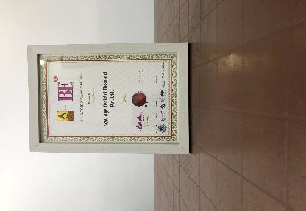
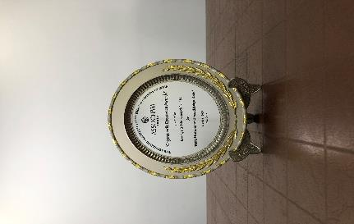

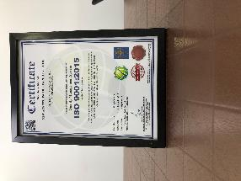


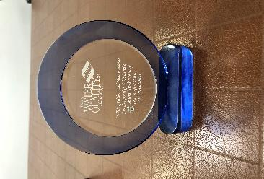


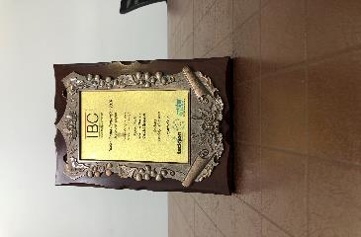

ChemAnalyst- Awards & Recognition
Best Application of Research Award at World Marketing Congress by ABP News ( 2018 )
Organic India Excellence Awards by ASSOCHAM India (2018)
Business-to-Business Research Award at Brand Excellence Awards by ABP News (2018)
Quality Management System by ISO (2018)
Best Application of Research Award at World Marketing Congress by ABP News ( 2017 )
Award for Best Place to Work in Research at World Marketing Congress by ABP News (2017)
Recognition from Silicon India Magazine
Recognition & Appreciation from WQIA
Best Market Research & Management Consulting Manufacturing Processby Wafisilpa Entertainments
Leadership Award from World Marketing Congress
Leadership Award from World Marketing Congress

Slide 56





























Our Prestigious Clients Who Bought Reports in Chemical Industry

Slide 57







Disclaimer :
The contents of this report are based on information generally available to the public from sources and primary interviews which are believed to be reliable. No representation is made that it is timely, accurate or complete. TechSci Research has taken due care and caution in compilation of data as this has been obtained from various sources including primary interviews which it considers reliable and firsthand. However, TechSci Research does not guarantee the accuracy, adequacy or completeness of any information and it is not responsible for any errors or omissions or for the results obtained from the use of such information and especially states that it has no financial liability whatsoever to the subscribers / users of this report. The information herein, together with all estimates and forecasts, can change without notice. All the figures provided in this document are indicative of relative market size and are strictly for client’s internal consumption. Usage of the same for purpose other than internal will require prior approval of TechSci Research.
CONTACT US
TechSci Research – North America
2950, Boundary Road, Burnaby, British Columbia, Canada
Tel: +1- 646- 360-1656
E: sales@techsciresearch.com
TechSci Research – Europe
54, Oldbrook, Bretton,
Peterborough,
United Kingdom
E: sales@techsciresearch.com
TechSci Research – Asia-Pacific
B-44, Sector -57, Noida, National Capital Region, UP, India
Tel: +91-120-4523900
E: sales@techsciresearch.com
TechSci Research
Cyber City, Building No. 8C, Gurgaon, National Capital Region, Haryana, India
Tel: +91-124-6428661
E: sales@techsciresearch.com
www.techsciresearch.com
INDUSTRY ASSOCIATIONS
The information contained herein is of a general nature and is not intended to address any particular situation, individual or entity. No one should act upon such information without appropriate professional advice.
2021 © TechSci Research All Rights Reserved.

